Slide 1
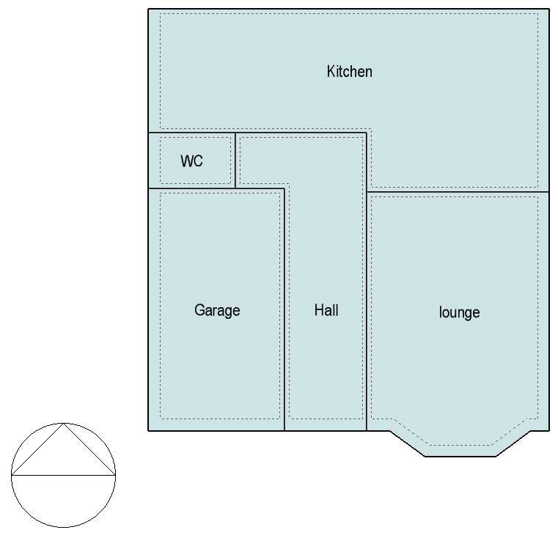
Ground floor
X
Location of the first environmental sensor

Slide 2
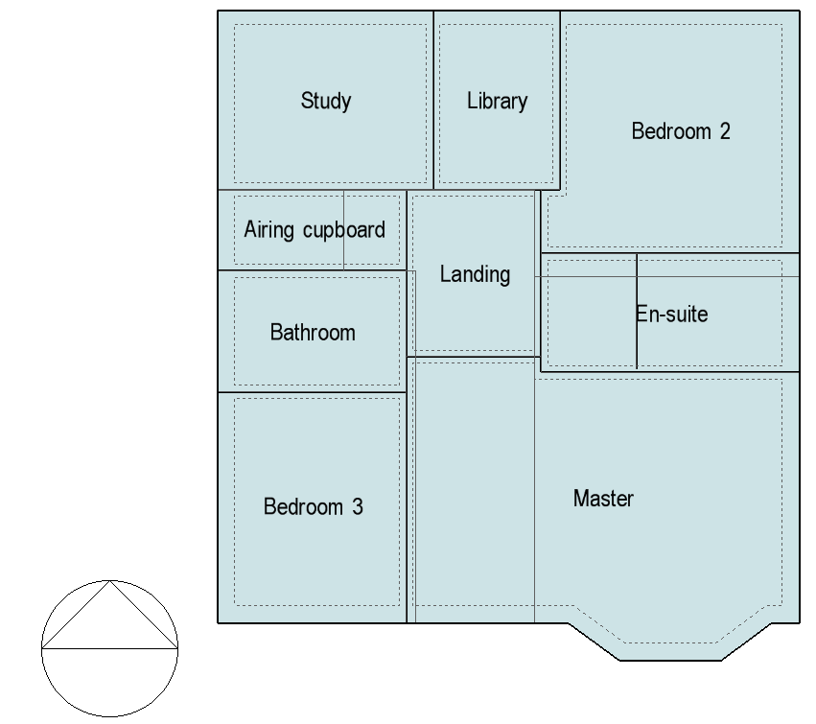
First floor
Location of the second environmental sensor
X

Slide 3
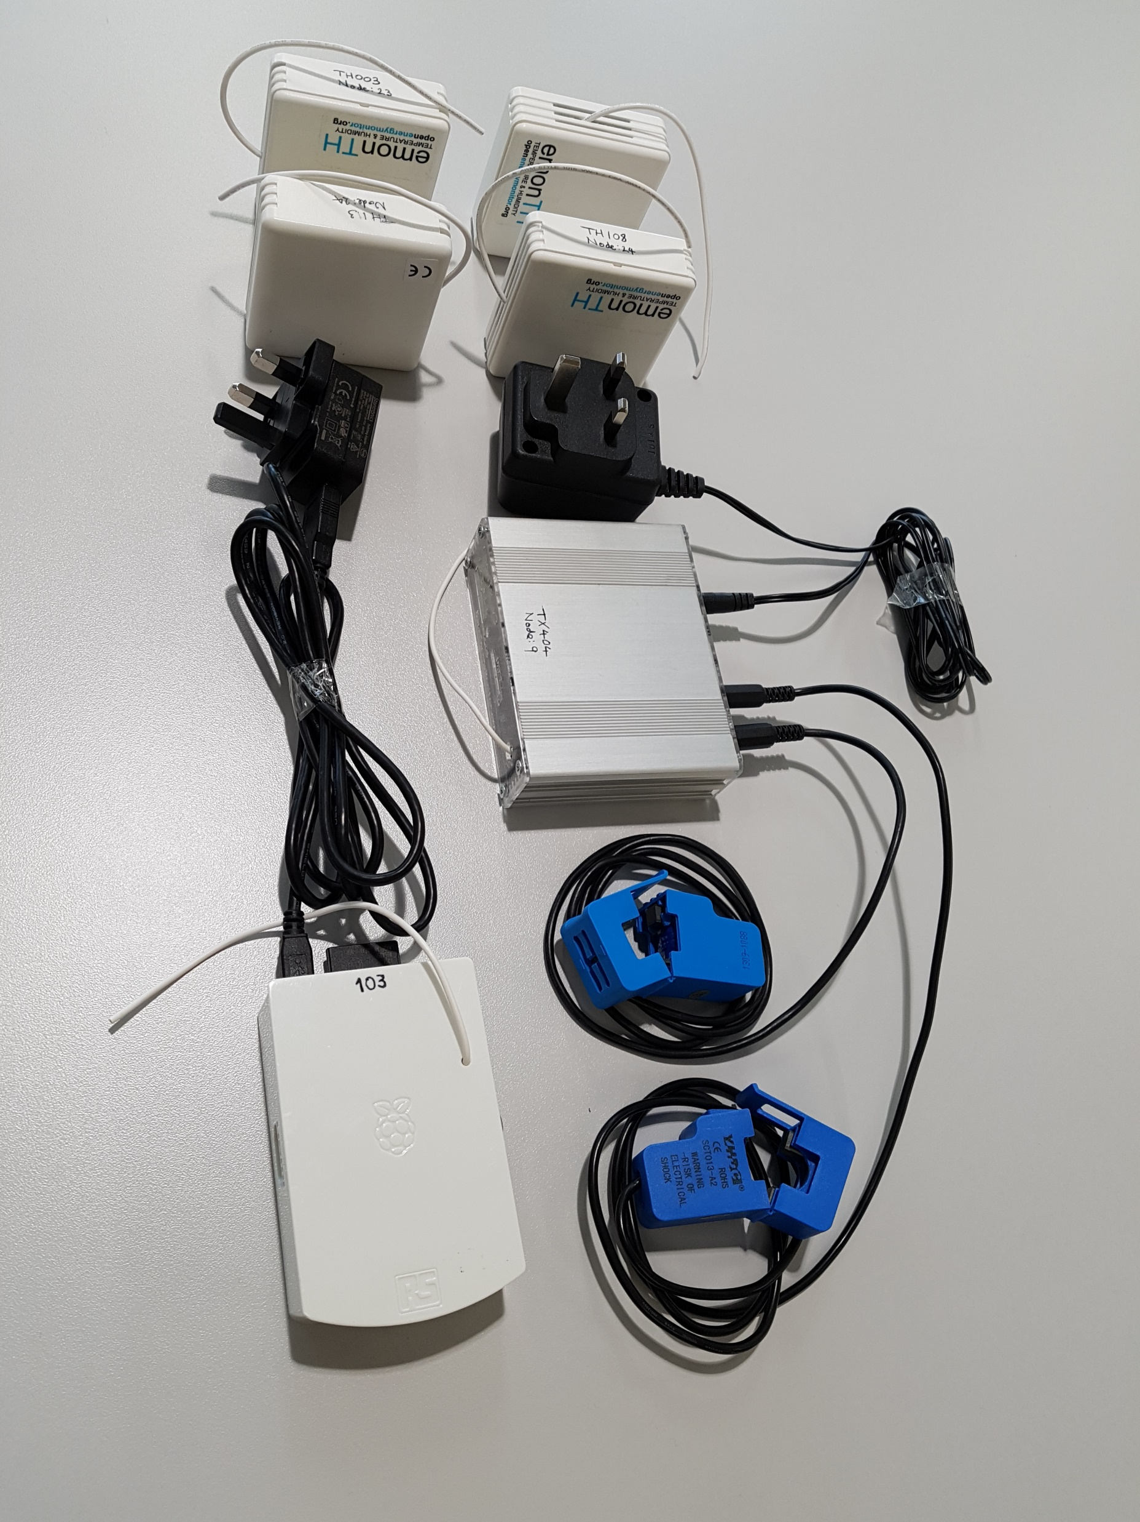
Proprietary energy and environmental sensors deployed in case study home

Slide 4
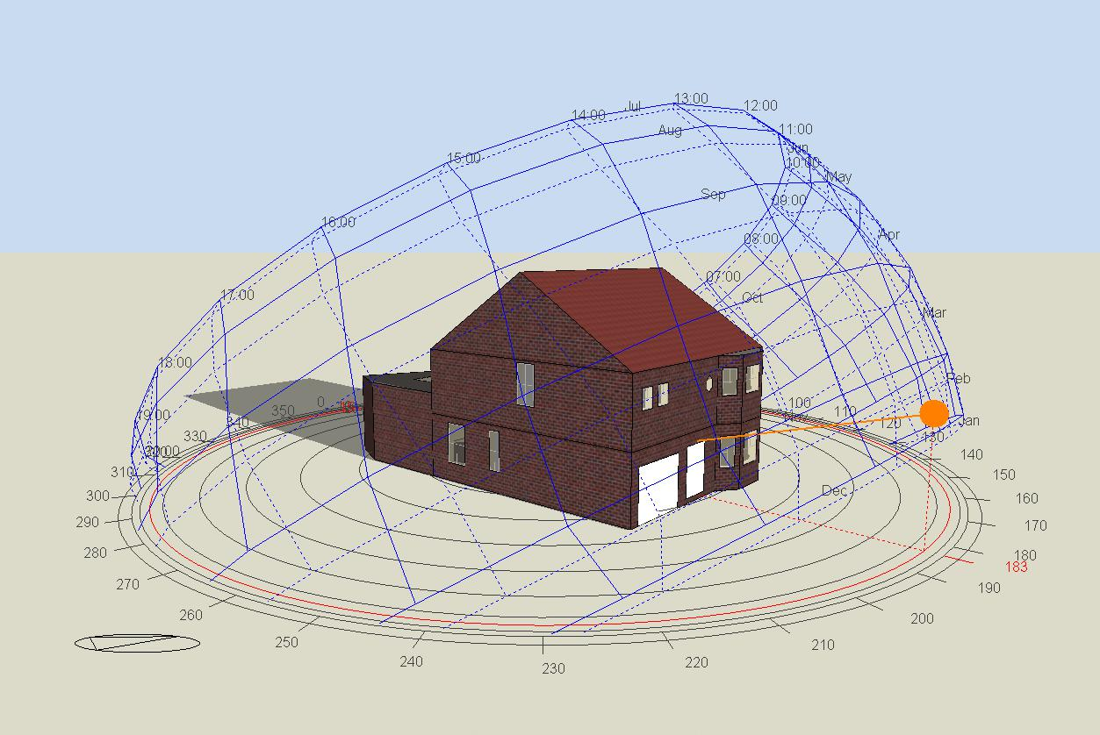
EnergyPlus building model

Slide 5
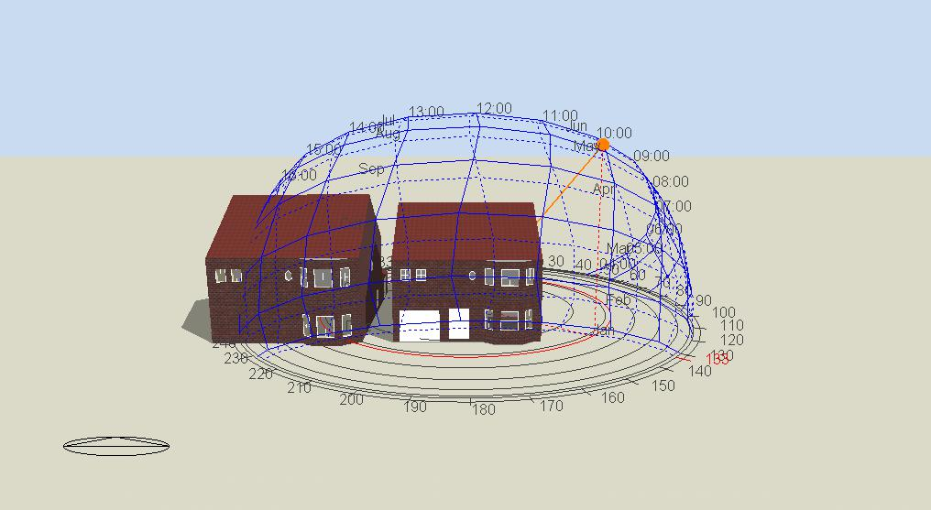
EnergyPlus building model – adjacent buildings were also modelled to account for microclimatic urban fabric impacts

Slide 6
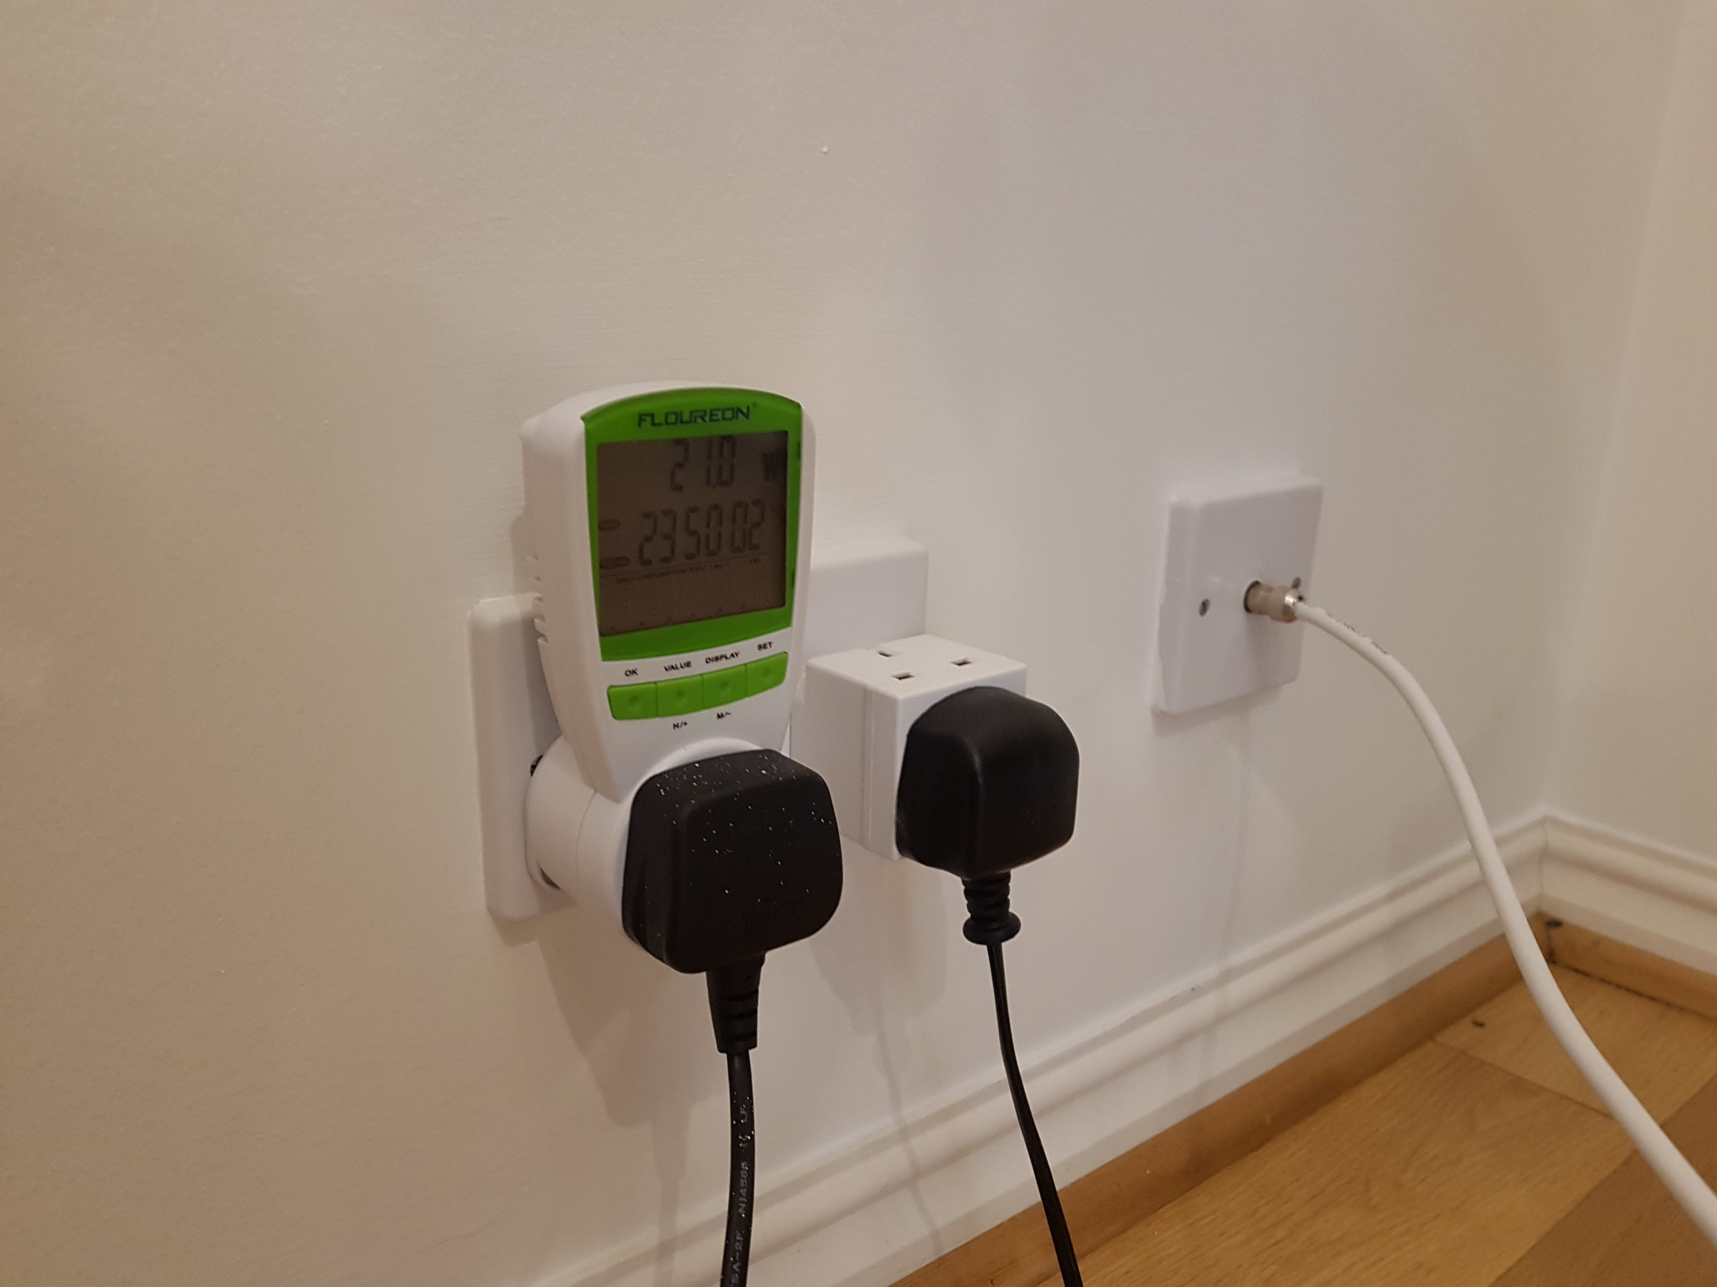
Determining the average and cumulative active electrical loads of household items for model parameterisation using a plugin wattmeter

